Slide 1

Pre-Submission Seminar on Obstacle Course Game Using Unity
Presented By
Gaurav Shripad
Guided By
Asst. Prof. Ratnesh K. Choudhary
Department of Computer Science & Engineering
S. B. JAIN INSTITUTE OF TECHNOLOGY MANAGEMENT AND RESEARCH,NAGPUR
An Autonomous Institute, Affiliated to RTMNU, Nagpur

Slide 2
Contents
Problem Statement & Objectives
Introduction
System Design
Developed Modules
Modules Description
Screenshots
Technology Used
Advantages & Applications
Conclusion
Future scope
Participation Summary
References
S. B. Jain Institute of Technology Management and Research
2

Slide 3
Problem Statement & Objectives
Problem Statement:
When children encounter the obstacles in an obstacle course, they develop and enhance strength and balance. In life and school, kids need to be able to remember lots of information.
They also need to learn how to solve problems based on sequencing information and actions. By running an obstacle course game, children develop and enhance these skills.
Objectives
Not only does it help them exercise and strengthen muscles, but it also assists with their gross motor skill, hand-eye coordination and overall health and wellbeing. These are all crucial to early childhood education.
S. B. Jain Institute of Technology Management and research
3

Slide 4
Introduction
Obstacle Course Game is all about enhancing motor skills to improving memory and decision-making , courses like Challenge Course can make a positive and lasting impact in children of all ages.
Outdoor obstacle courses help children solve problems as they learn how to maneuver up, over, or through an obstacle. They also learn how to adjust to changing conditions and memorize the fastest way to progress through the course.
The main aim of this project is providing to children to improve Memory and Problem Solving, Sensory Processing, Motor Skills etc.
The owner can easily use it to teach children how to play obstacle course game and improving their memory and logical problem solving which will help them in future as they grow.
S. B. Jain Institute of Technology Management and research
4

Slide 5
Literature Survey
Websites / Paper / Article | Reviews / Findings
1. Theverge | Fall Guys is a delightful and colorful trifle: the perfect counter programming to the year 2020. Battle royale games used to feel fast and exciting to me, but they’ve largely become dark and stressful slogs with awkward pacing and too much waiting time. Fall Guys avoids these pitfalls by lowering the stakes, cutting out a lot of waiting time, and providing plenty of charming and kinetic goofs. When I fail in Fall Guys, I often end up laughing at myself. If you get disqualified, it’s easy to join a new game and start playing again right away. And even if you qualify through to the end, most matches only last about 15 minutes from start to finish.
2. flintobox | Obstacle courses are easy to set up and one of the best mind games for kids. You can set one up right in your living room. Create simple obstacle courses using household supplies, increase the complexity with creative obstacles for older kids. Obstacle courses help enhance your child’s gross motor, visual perception, motor planning, coordination, problem-solving, critical thinking and language skills.

Slide 6
System Design: Flowchart
Obstacle Course Flowchart:
Player
Camera (Follow Player)
Object (Moveable, player)
Exit(ESC)
Travel from A
Obstacles (To avoid)
Static Object
Spinning Object
Falling Object
Rolling Object
Travel to B
S. B. Jain Institute of Technology Management and research
6

Slide 7
Developed Modules
1. What Player must Experience:
She/he want to be careful ,Clever, Nimble, Agile
Core Mechanism:
The player must move the object and Dodge Obstacles
Game Loop:
Player needs to move the object from position A to B
Input Mechanism:
for movement of a player there is the universal keys such as
up arrow, down arrow, right arrow, left arrow keys or can use
W for up, S for Down, D for moving Right side, A for moving Left side.
Output Mechanism:
Object must Travel From A to B in Such a way that it avoids all the obstacle
in its path. With the help of keys.
S. B. Jain Institute of Technology Management and research
7

Slide 8
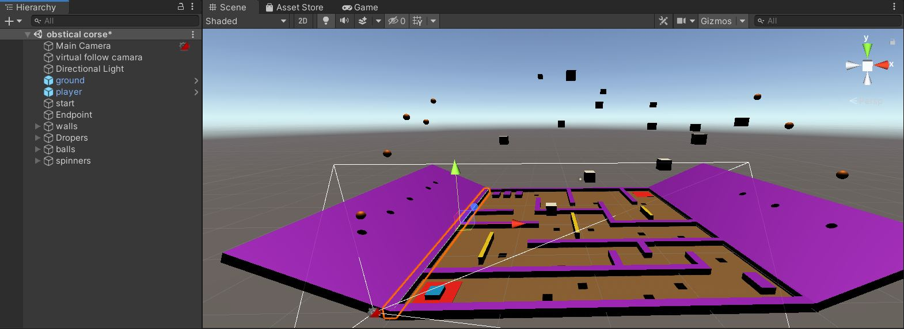
ScreenShots
S. B. Jain Institute of Technology Management and research
8

Slide 9
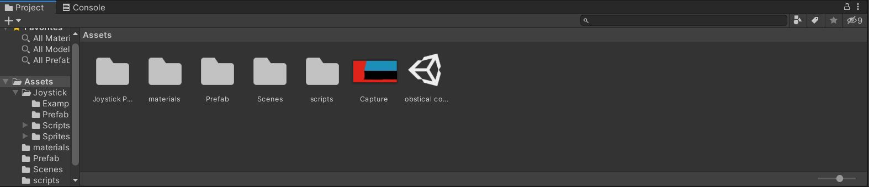
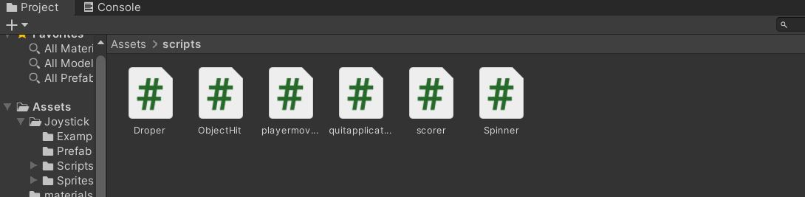

Slide 10
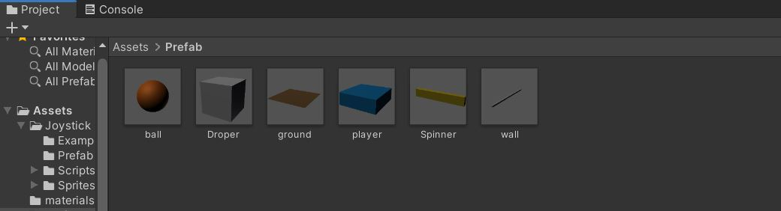
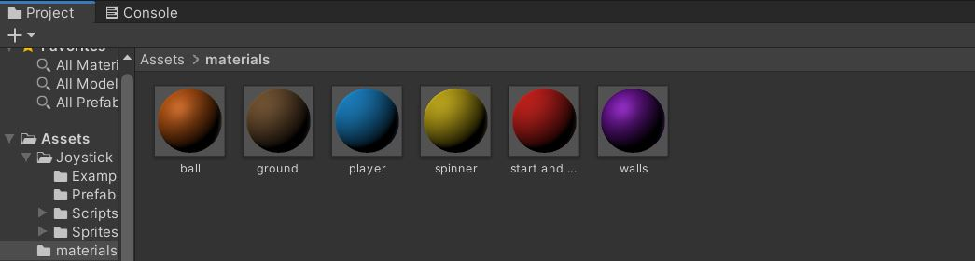

Slide 11
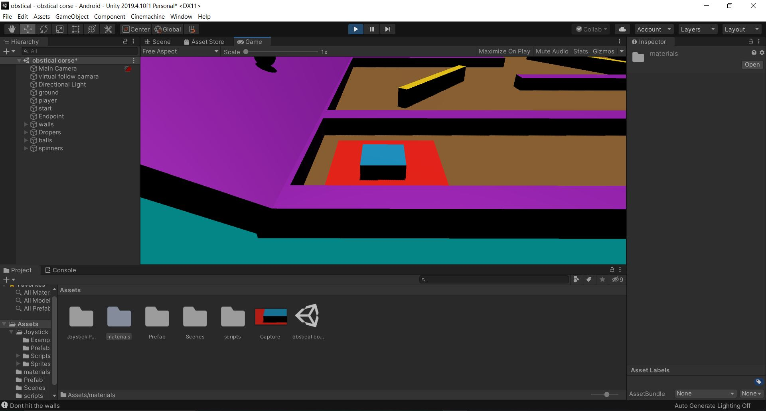

Slide 12
Technology Used
Front End:
Unity Game Engine
Back End:
C#
S. B. Jain Institute of Technology Management and research
12

Slide 13
Advantages & Applications
It is user-friendly software.
It is cost-effective and easy to install.
It is very use full to develop memory skills as well as problem solving of children's.
Application:
It is used in any education institute can make use on Children from age 4+ to develop their memory and problem solvings.
S. B. Jain Institute of Technology Management and research
13

Slide 14
Conclusion
We have entirely completed our project, and our proposed system is designed to reduce the time and save the efforts of the faculties
for children to develop there problem solving skills.
The project Obstacle Course Game is totally computerize. The software takes care of all the requirements of an a Children and is capable to provide enough problem solving situation to develop their logic to built. During the development of the project we understood the importance of individual and team work while project development and management.
While presenting in various seminar we have enhanced our communication skills and displayed professional ethics which will result in lifelong ethics.
S. B. Jain Institute of Technology Management and research
14

Slide 15
Future Scope
DESCRIPTION OF FEATURE :
It can be useful in educational institutes to develop the logic and problem solving of children.
It can be use by parents for their children to develop the logic and problem solving.
S. B. Jain Institute of Technology Management and research
15

Slide 16
Thank You

